Slide 1
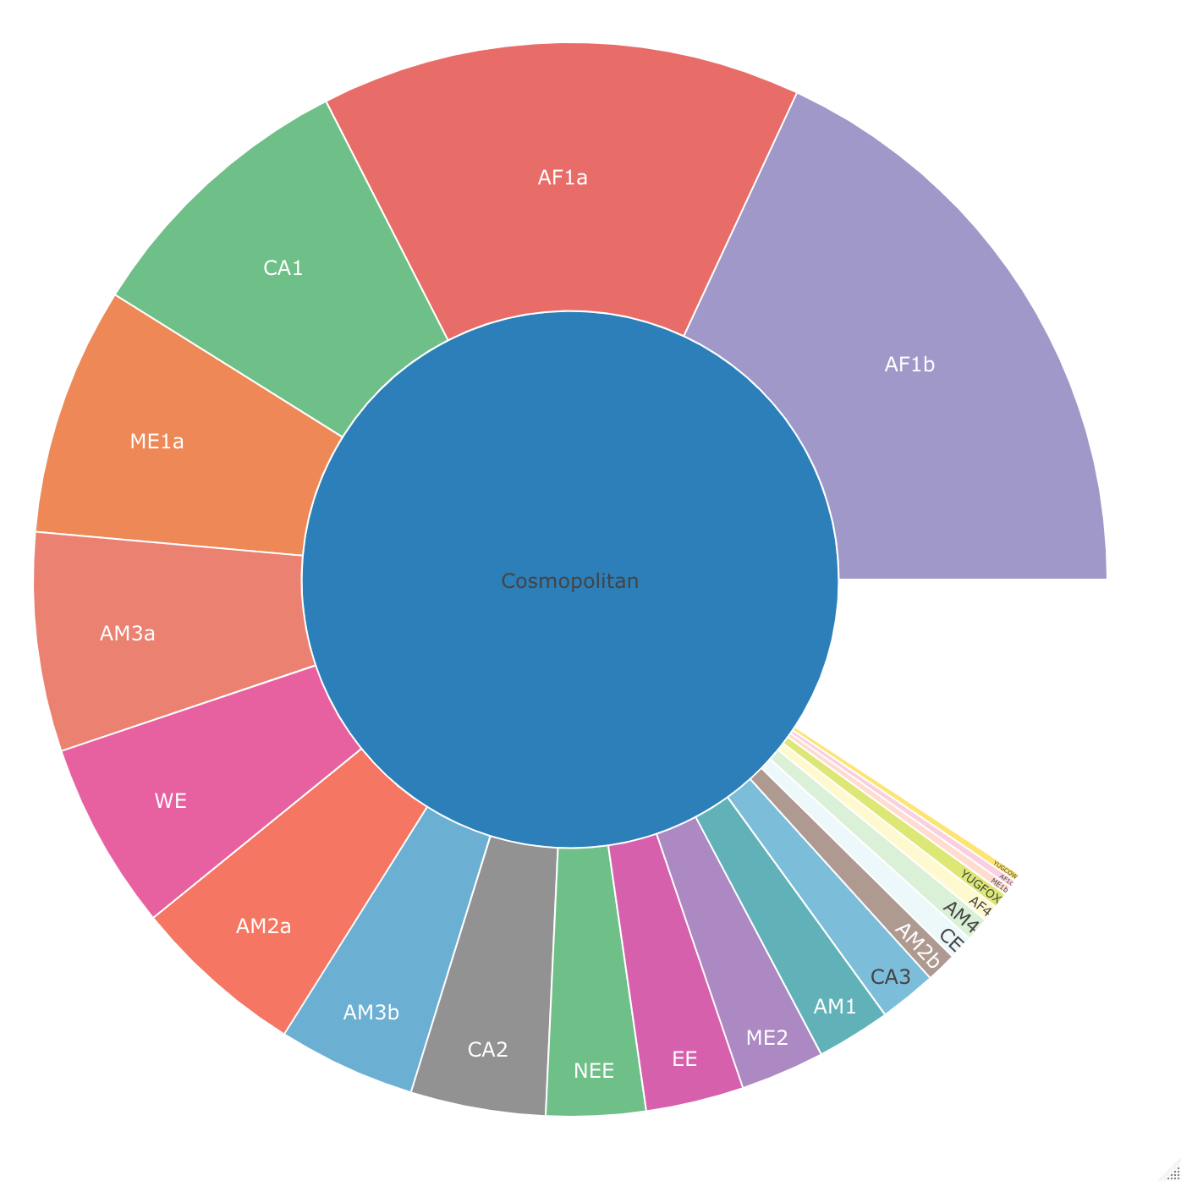
Cosmopolitan
Fig1: Hierarchal relationship of the 23 existing subclades of the cosmopolitan clade

Slide 2
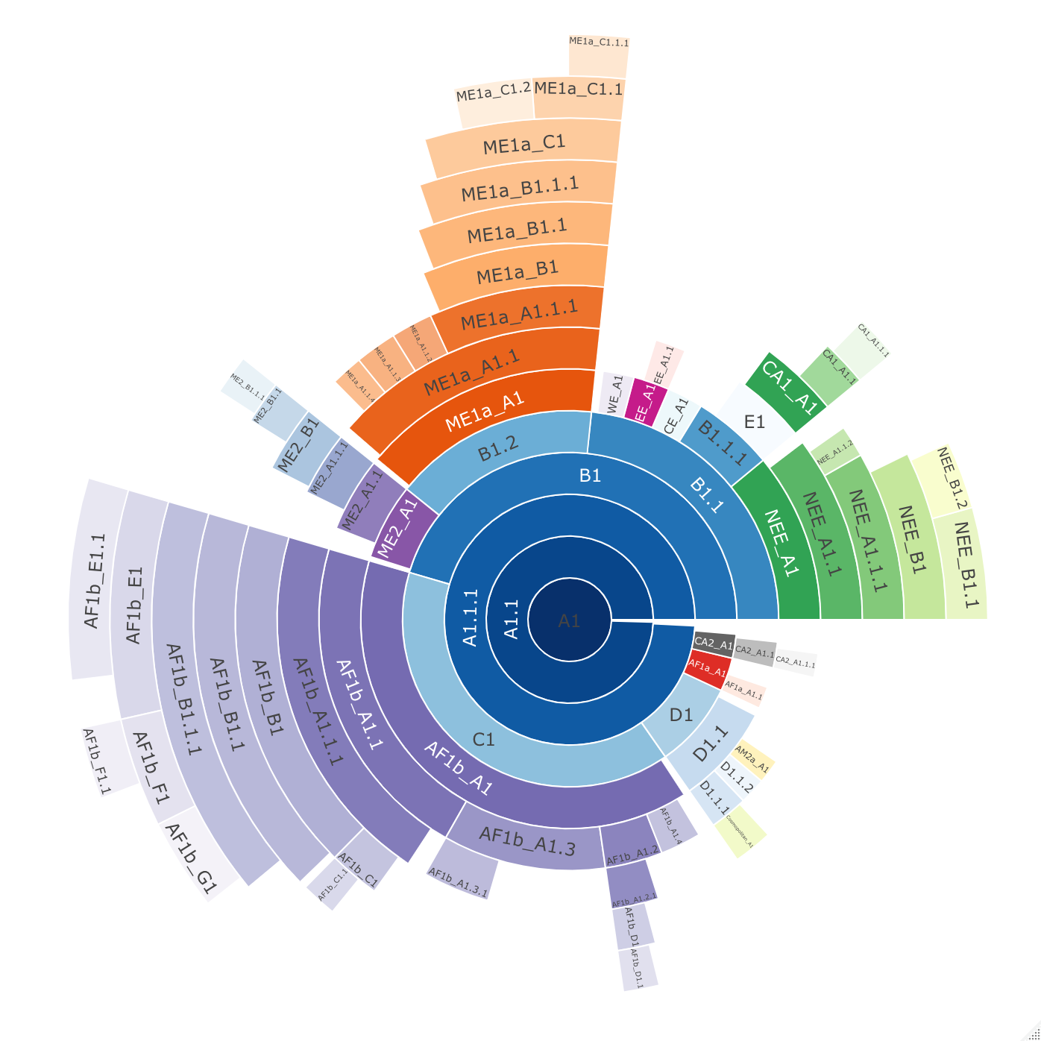
b)
a)
Fig2: Lineage designation of 650 whole genome (10,000nt) rabies virus sequences from the Cosmopolitan clade, obtained from RABV-GLUE. A) Maximum likelihood tree showing the lineage positions with terminal lineages collapsed. B) Hierarchal relationships of the lineages.

Slide 3
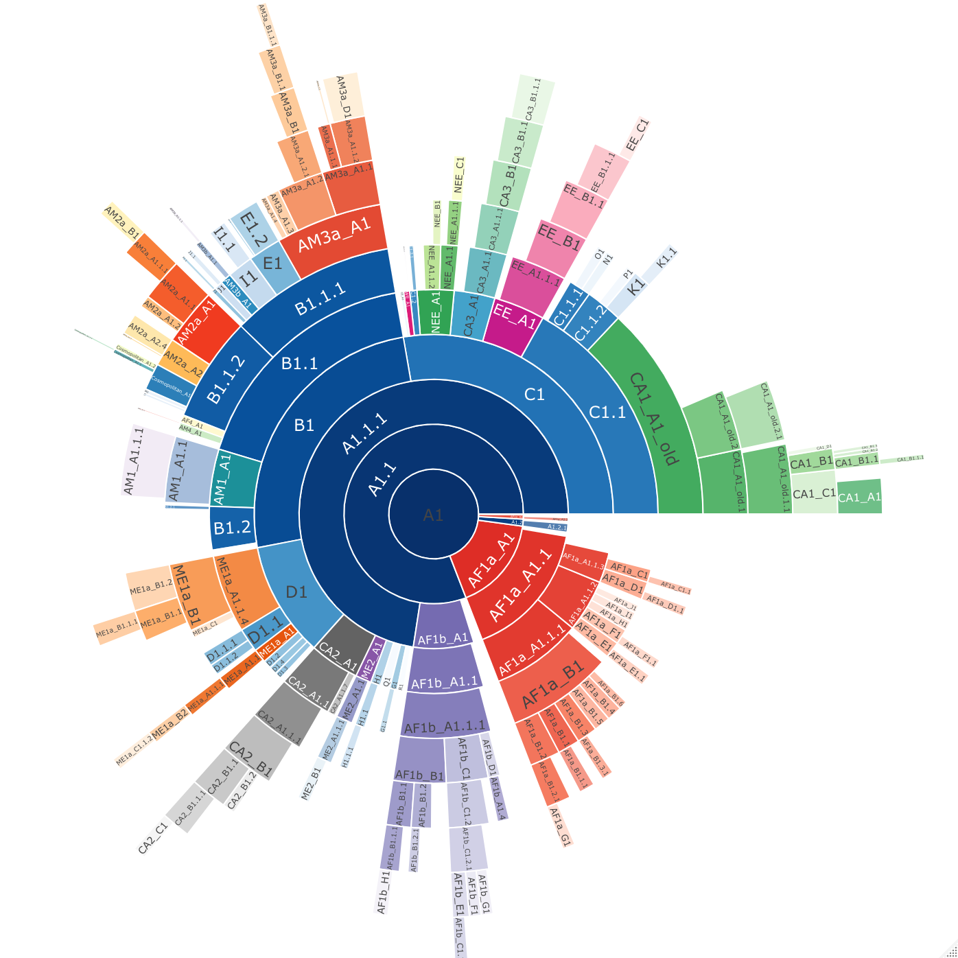
b)
a)
Fig3: Lineage designation of 2126 N gene length (1300nt) rabies virus sequences from the Cosmopolitan clade, obtained from RABV-GLUE. A) Maximum likelihood tree showing the lineage positions with terminal lineages collapsed. B) Hierarchal relationships of the lineages.

Slide 4
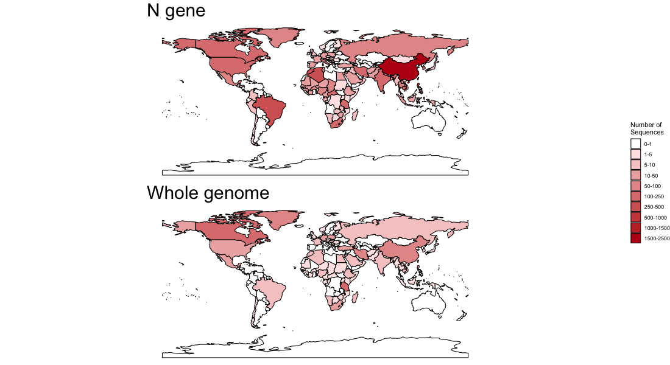
Fig4: Number of publicly available rabies virus sequences available per country of at least N gene length - 1300nt (n = 2126), and whole genome sequences - >10,000nt (n = 650).

Slide 5
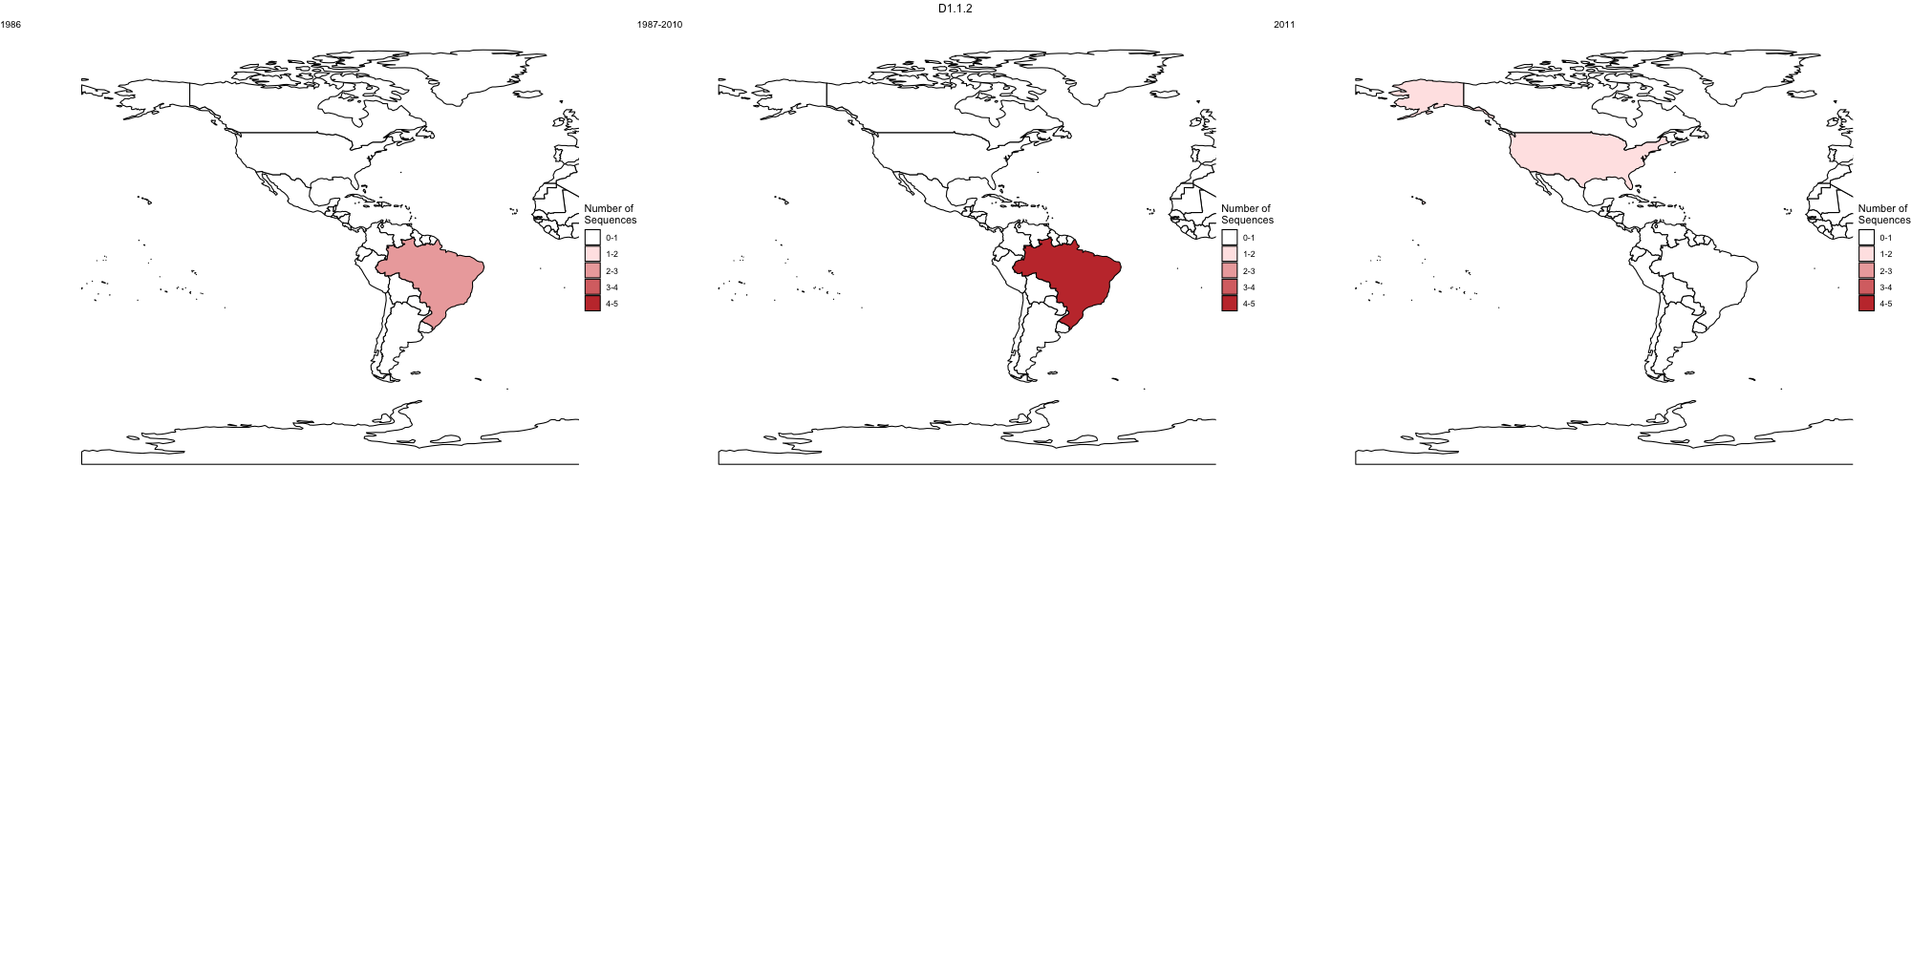
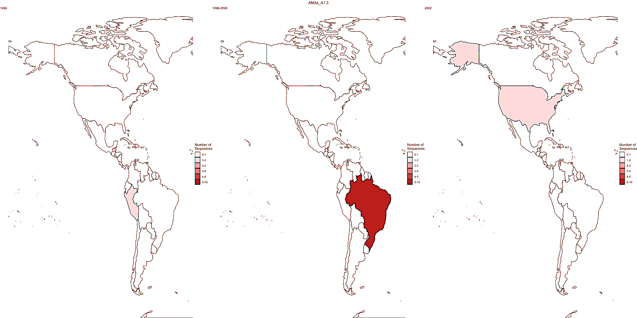
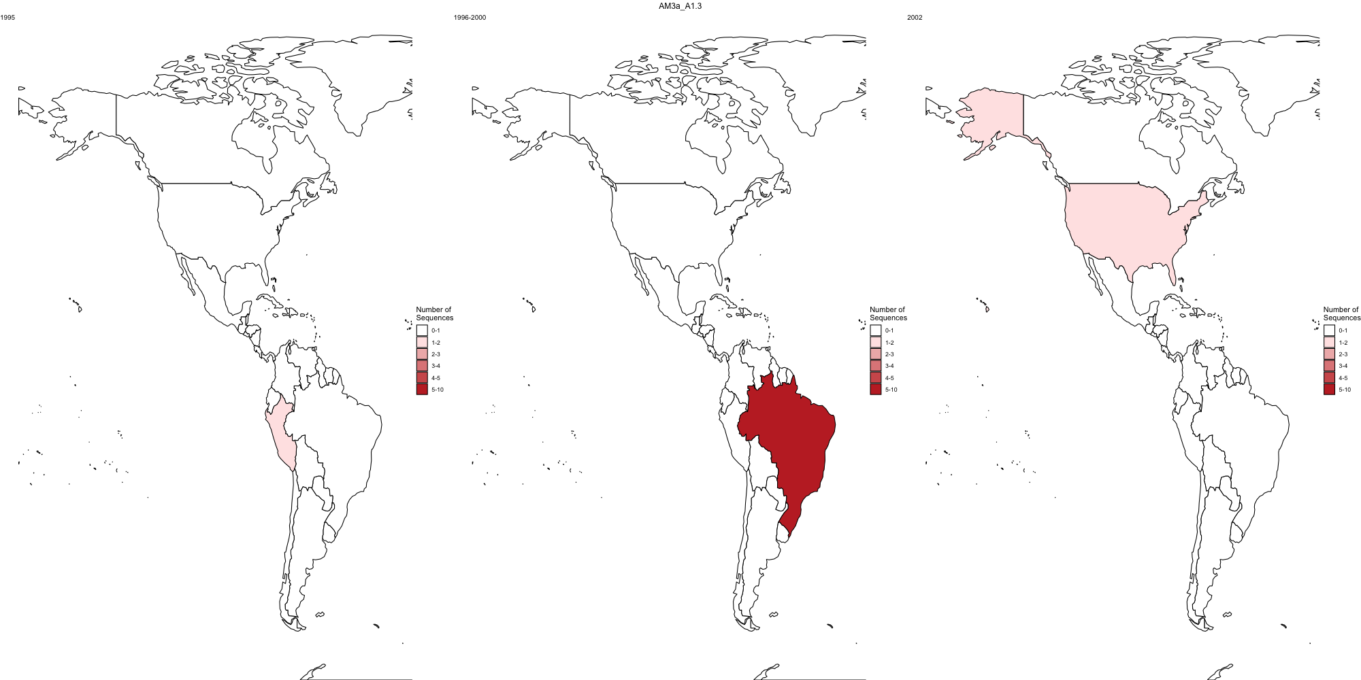
Whole genome lineage D1.1.2
1987– 2010
2011
N gene lineage AM3a_A1.3
1999
Fig5: Global distribution of a lineage over time. With whole genome lineage designation, this lineage is called D1.1.2 (above). With N gene designation this lineage is called AM3a_A1.3 (below)

Slide 6
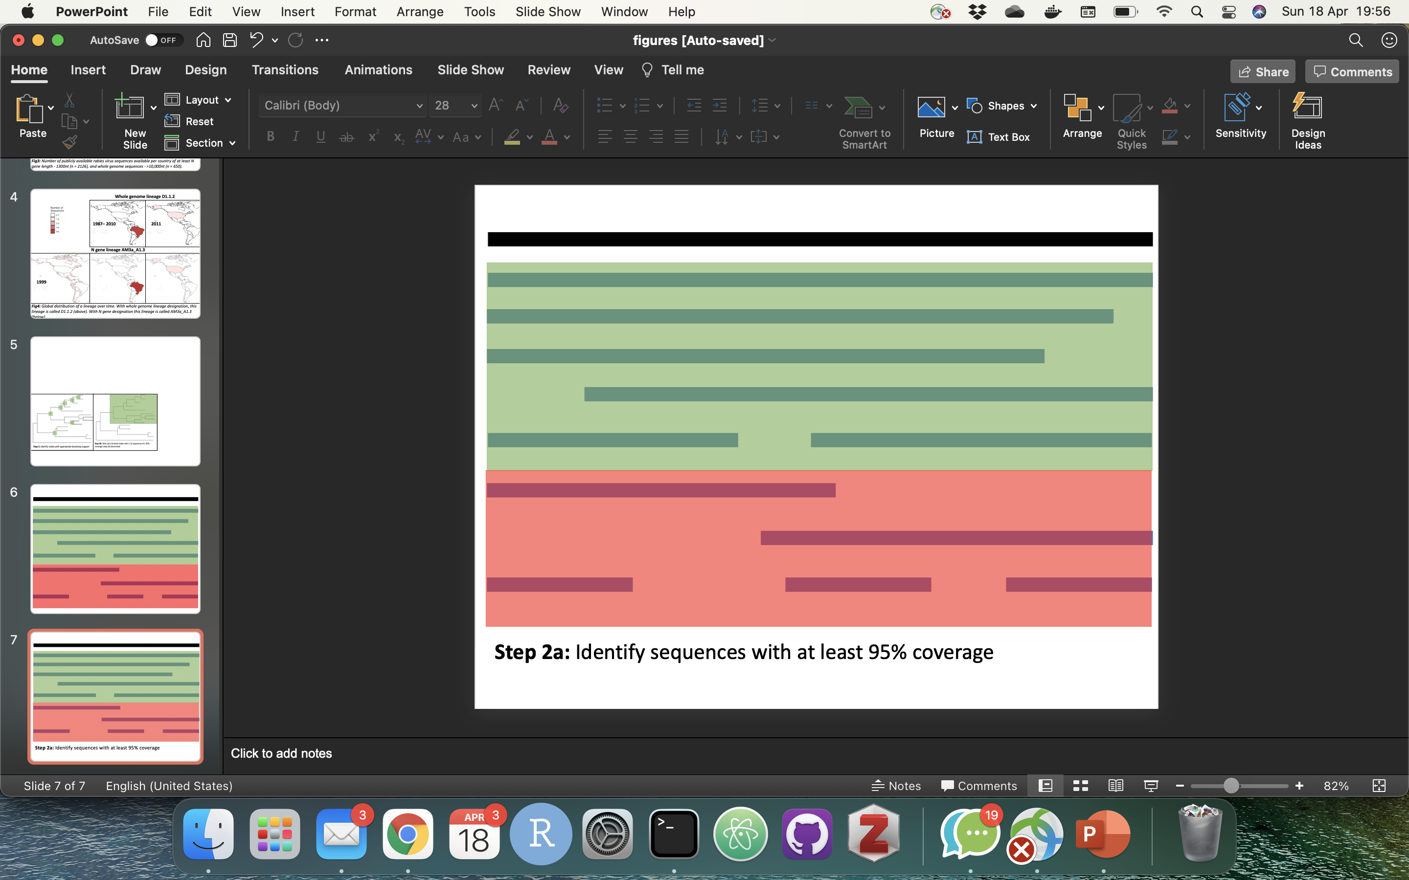
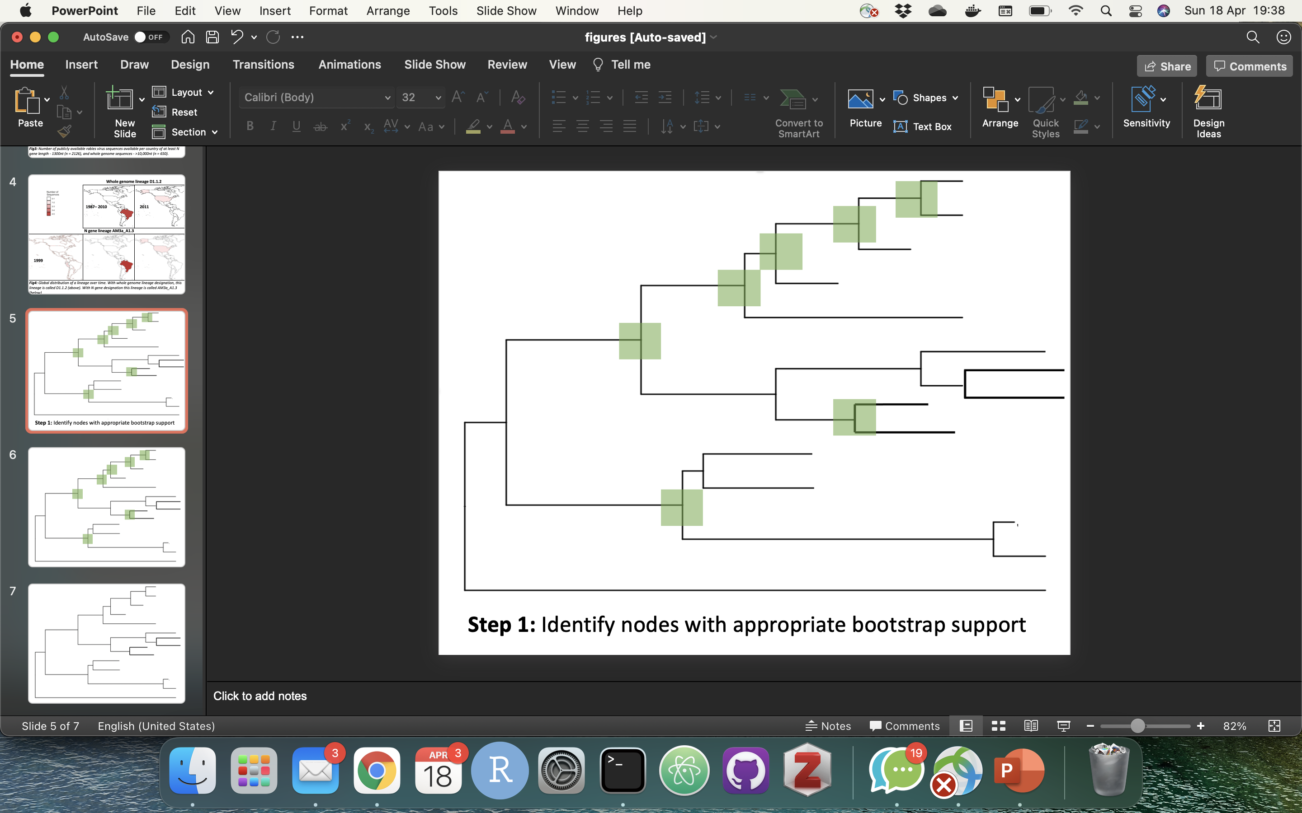
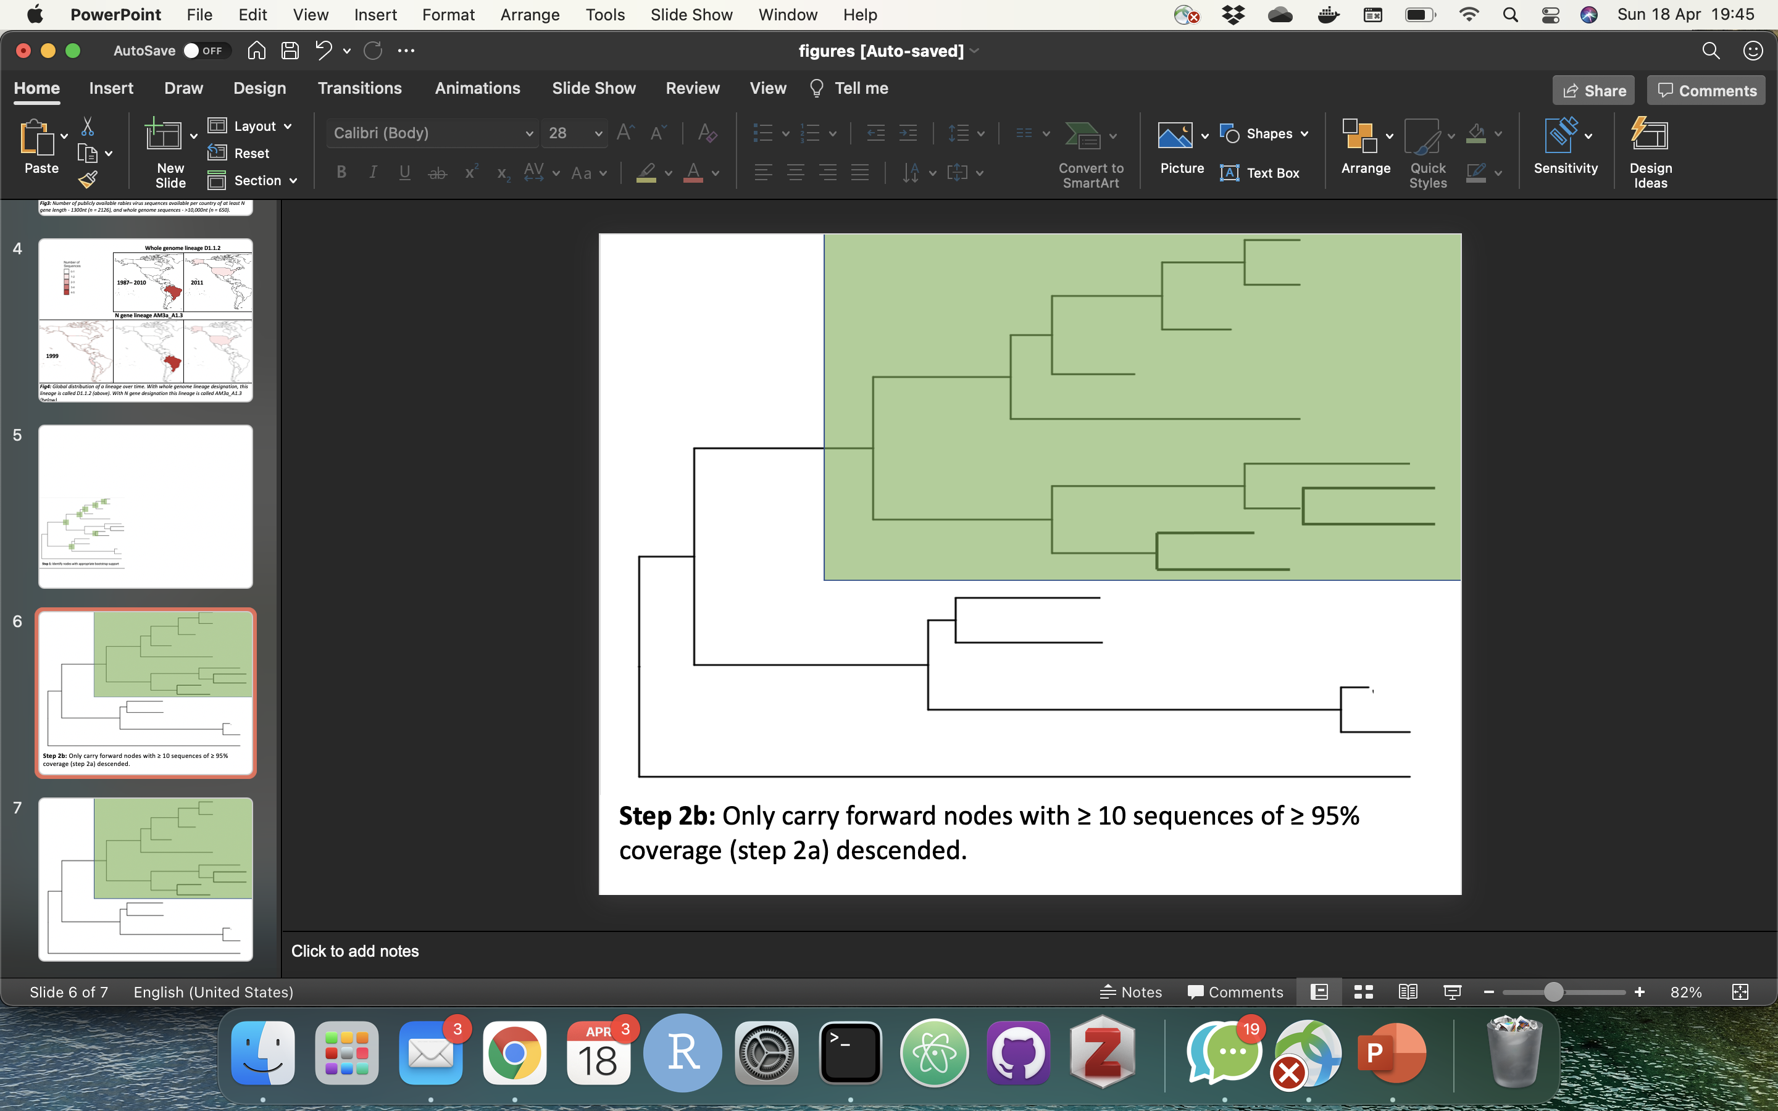
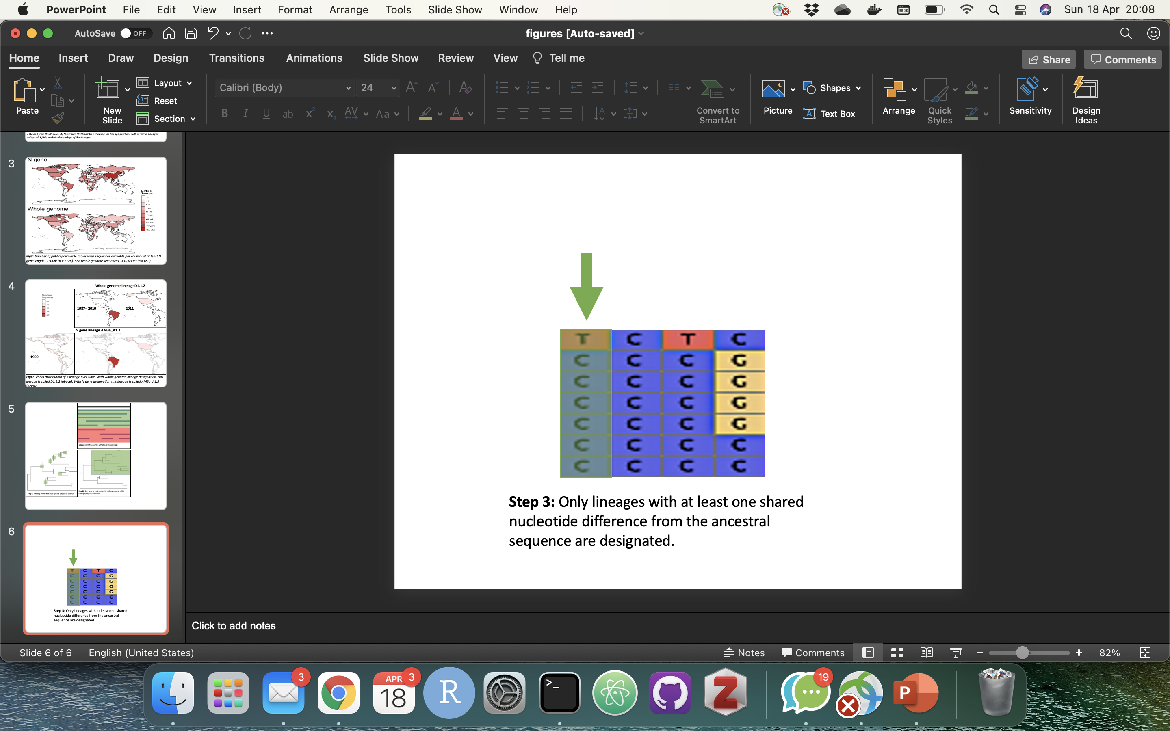
Fig6: Summary of lineage designation steps

